Slide 1


Modeling Sustainable Energy Transitions on Different Scales
Dénes Csala
Modeling Complex Energy
Systems Workshop | 13/10/15
20 trillion green watts

Slide 2
20 trillion green watts
Notes:
Wealthy countries could afford to do that because of fossil fuels. 2 problems with that. Depletion and global warming.

Slide 3
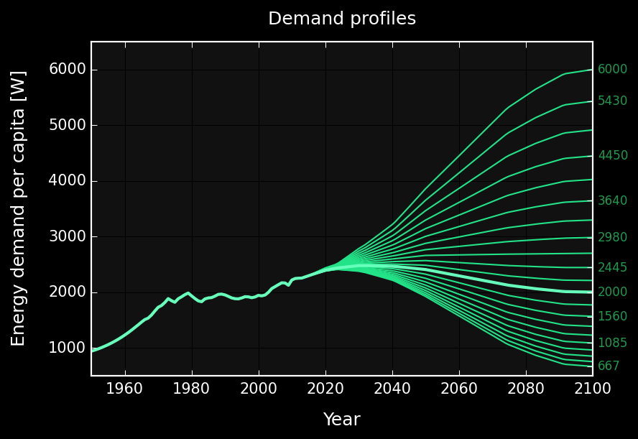
2000 W / capita ∙ 10 billion people = 20 trillion W
Pickard (2014)
Trainer (2014)
Spreng (2005)
Project Novatlantis (2004)
Marechal et al. (2005)
Jacobson , Delucchi (2011)
MIT SOLVE (2015)
An average net primary power of 2000W per capita may be considered as a lower limit for maintaining an acceptable quality of life in a technical society.
Marechal et al. (2005), Pfeiffer et al. (2005),
Spreng (2005), Schultz et al. (2008), Huebner (2009)
GRAPH: Own work based on open energy data from EIA (1970-2040), BP (1960-2035), population data from UNSD, (1950-2100)

Slide 4
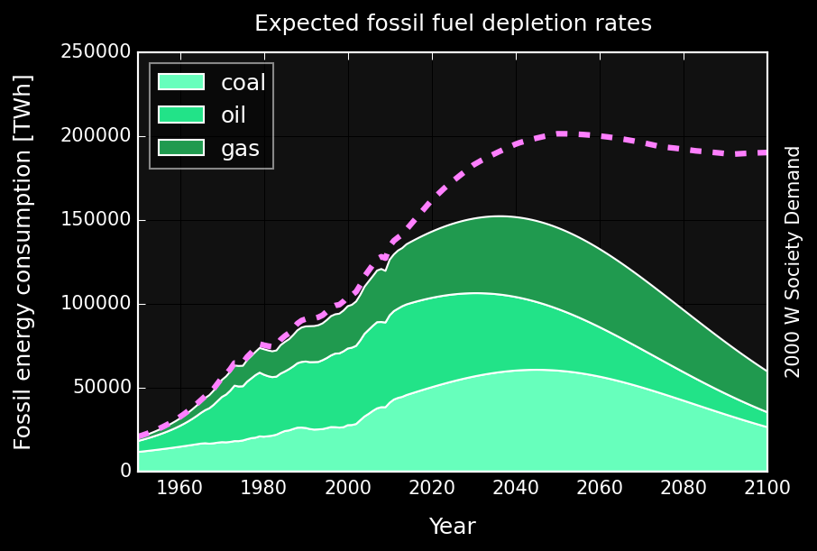
IPCC AR5 WG1 RCP2.6
Carbon budget*
990 GtCO₂
[510 – 1505]
2032
[2020-2045]
GRAPH: Own work based on open energy data from EIA (1970-2040), BP (1960-2035), population data from UNSD, (1950-2100)
Maggio, Cacciola (2012), Mohr et al. (2015)
* Fossil fuels, industrial processes (including cement) and waste
Notes:
Wealthy countries could afford to do that because of fossil fuels. 2 problems with that. Depletion and global warming.
Potential reserves exceed the co budget by 35-60 times (6-7 proven reserves)

Slide 5
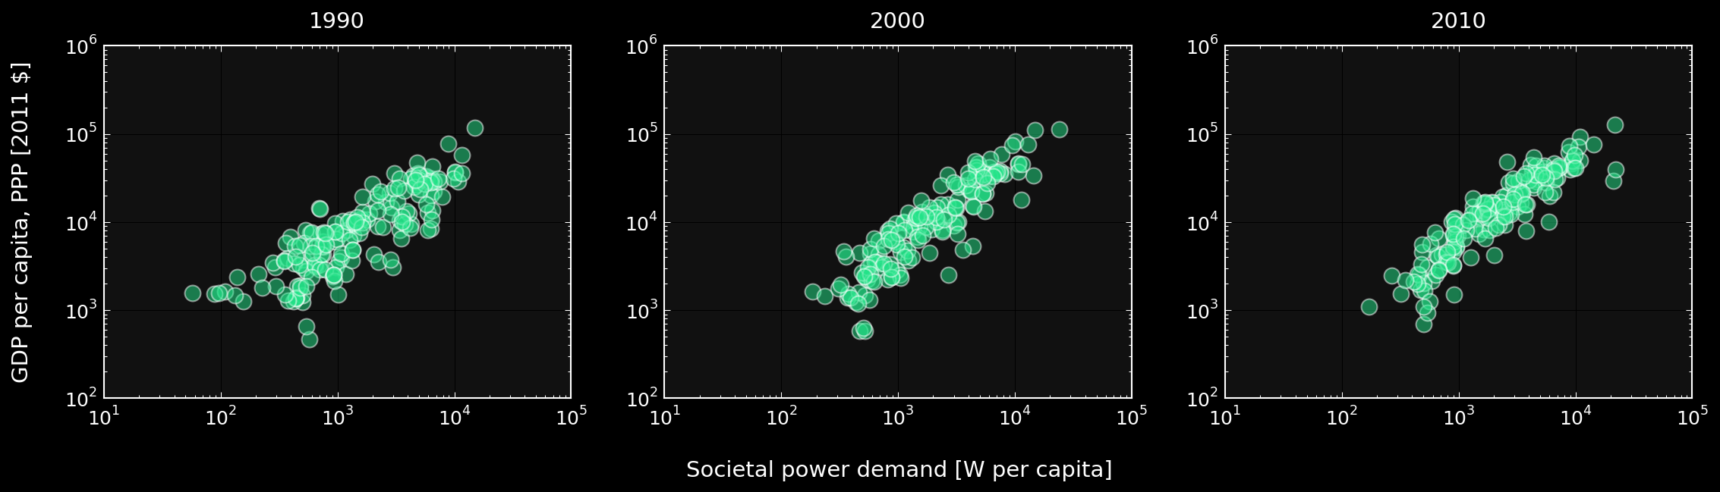
“Massive reductions in OECD countries would perhaps even leave room in the global CO₂-emission budget to allow poverty eradication as stipulated in the UN millennium goals without triggering catastrophic climate change.”
sustainable development
Spreng (2005)
GRAPH: Own work based on open energy and GDP data from World Bank (1990-2010)
Notes:
Wealthy countries could afford to do that because of fossil fuels. 2 problems with that. Depletion and global warming.

Slide 6
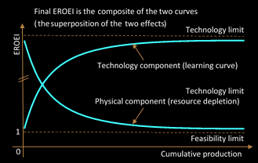
Energy Return on Energy Invested = EROEI
Solar PV 5 – 15
Wind 20 – 40
Solar CSP 10 – 20
Geothermal 15 – 35
Oil 25 – 10 [60 – 40]
Gas 25 – 15 [60 – 40]
Coal 50 – 15 [100 – 80]
Barnhart, Dale et al. (2013), Klemes (2015), Hall (2014)
King, Hall (2011), Gupta (2011), Moerschbaecher (2011), Kubiszewski (2010)
GRAPH: Own work based on Dale, Krumdieck (2012)
Notes:
Wealthy countries could afford to do that because of fossil fuels. 2 problems with that. Depletion and global warming.

Slide 7
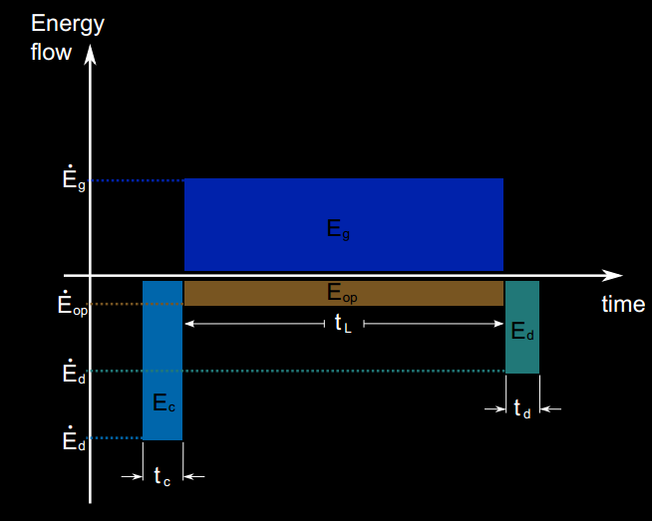
OPEX vs. CAPEX nature of Energy Investment
Fossil
Renewable
E_{op}
GRAPH: Murphy et al. (2011) and own work based on Murphy et al. (2011)
Notes:
Wealthy countries could afford to do that because of fossil fuels. 2 problems with that. Depletion and global warming.

Slide 8
sustainable energy transition

Slide 9
sustainable energy transition
The impacts from energy use during SET should not exceed the long-run ecosystem carrying and assimilation capacity.
Per capita net available energy should remain above a level that satisfies societal needs at any point during SET and without disruptive discontinuities in its rate of change.
The rate of investment in building renewable energy harvesting and utilization capital stock should be sufficient to create a sustainable energy supply basis before the non-renewable safely recoverable resources are exhausted.
Daly (1996), Sgouridis, Csala (2014), Sgouridis, Bardi, Csala (under review)
Notes:
Wealthy countries could afford to do that because of fossil fuels. 2 problems with that. Depletion and global warming.

Slide 10
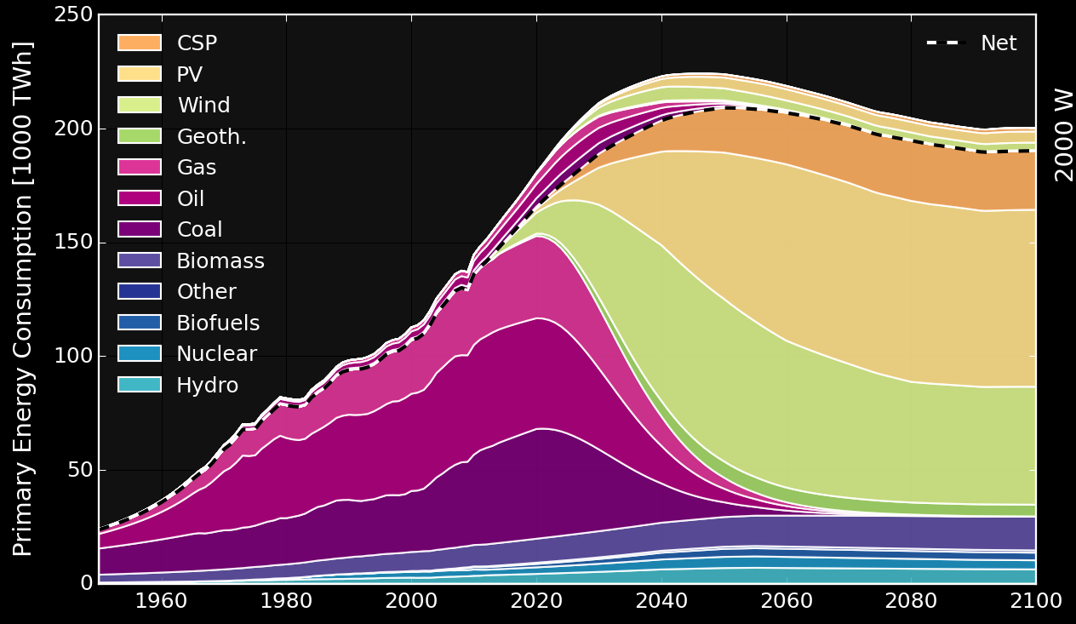
√ Carrying capacity
√ Societal needs
√ Sustainable investment
Sgouridis, Bardi, Csala (expected 2015)
GRAPH: Own work based on the principles outlined by Sgouridis, Csala (2014) using open data from EIA, BP, UNSD
Notes:
Wealthy countries could afford to do that because of fossil fuels. 2 problems with that. Depletion and global warming.

Slide 11
methods & results

Slide 12
methodology
Trade
data
[UN COMTRADE]
Renewable
EROEI
[Literature]
Sustainable Energy Transition Paths
Population projections
[UNSD]
Renewable energy data
Transition Feasibility Index
Demand data
Demand projections
[Literature]
Most Feasible Paths
Fossil
data
Renewable potential
[IRENA]
Emissions data
[IPCC, EIA, BP]
A data-driven, automated creation of feasible sustainable
energy transition paths for the globe and all nations

Slide 13
results
BAU
Planned: peak 2030, finish by 2100
Forced 2030
Forced 2020
What if the IPCC is wrong?
High cap 2020
Low cap 2020
Sustainable Energy Transitions Model 2.0 | Csala (2015)
http://set.csaladen.es
Notes:
Wealthy countries could afford to do that because of fossil fuels. 2 problems with that. Depletion and global warming.

Slide 14
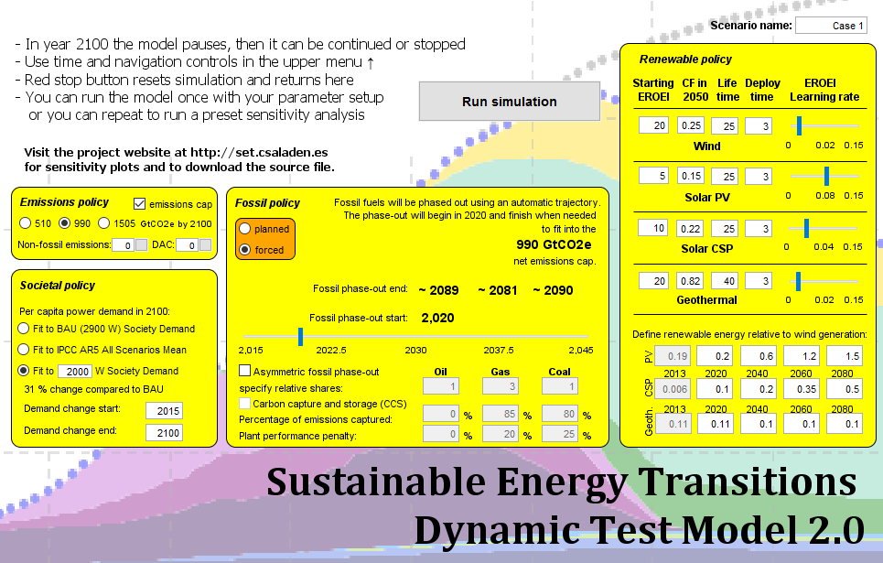
results
Sustainable Energy Transitions Model 2.0 | Csala (2015)
http://runthemodel.com/models/2104/
Notes:
Wealthy countries could afford to do that because of fossil fuels. 2 problems with that. Depletion and global warming.

Slide 15
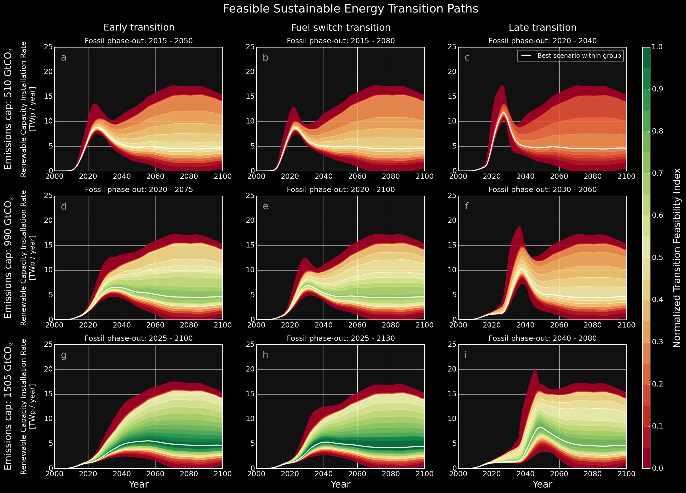
results
The transition envelopes are narrow during the early transition phase
Hitting the feasible region requires a 36 times increase in renewable energy installation rates within two decades
Sgouridis, Bardi, Csala (under review)
GRAPH: Own work
Notes:
Wealthy countries could afford to do that because of fossil fuels. 2 problems with that. Depletion and global warming.

Slide 16
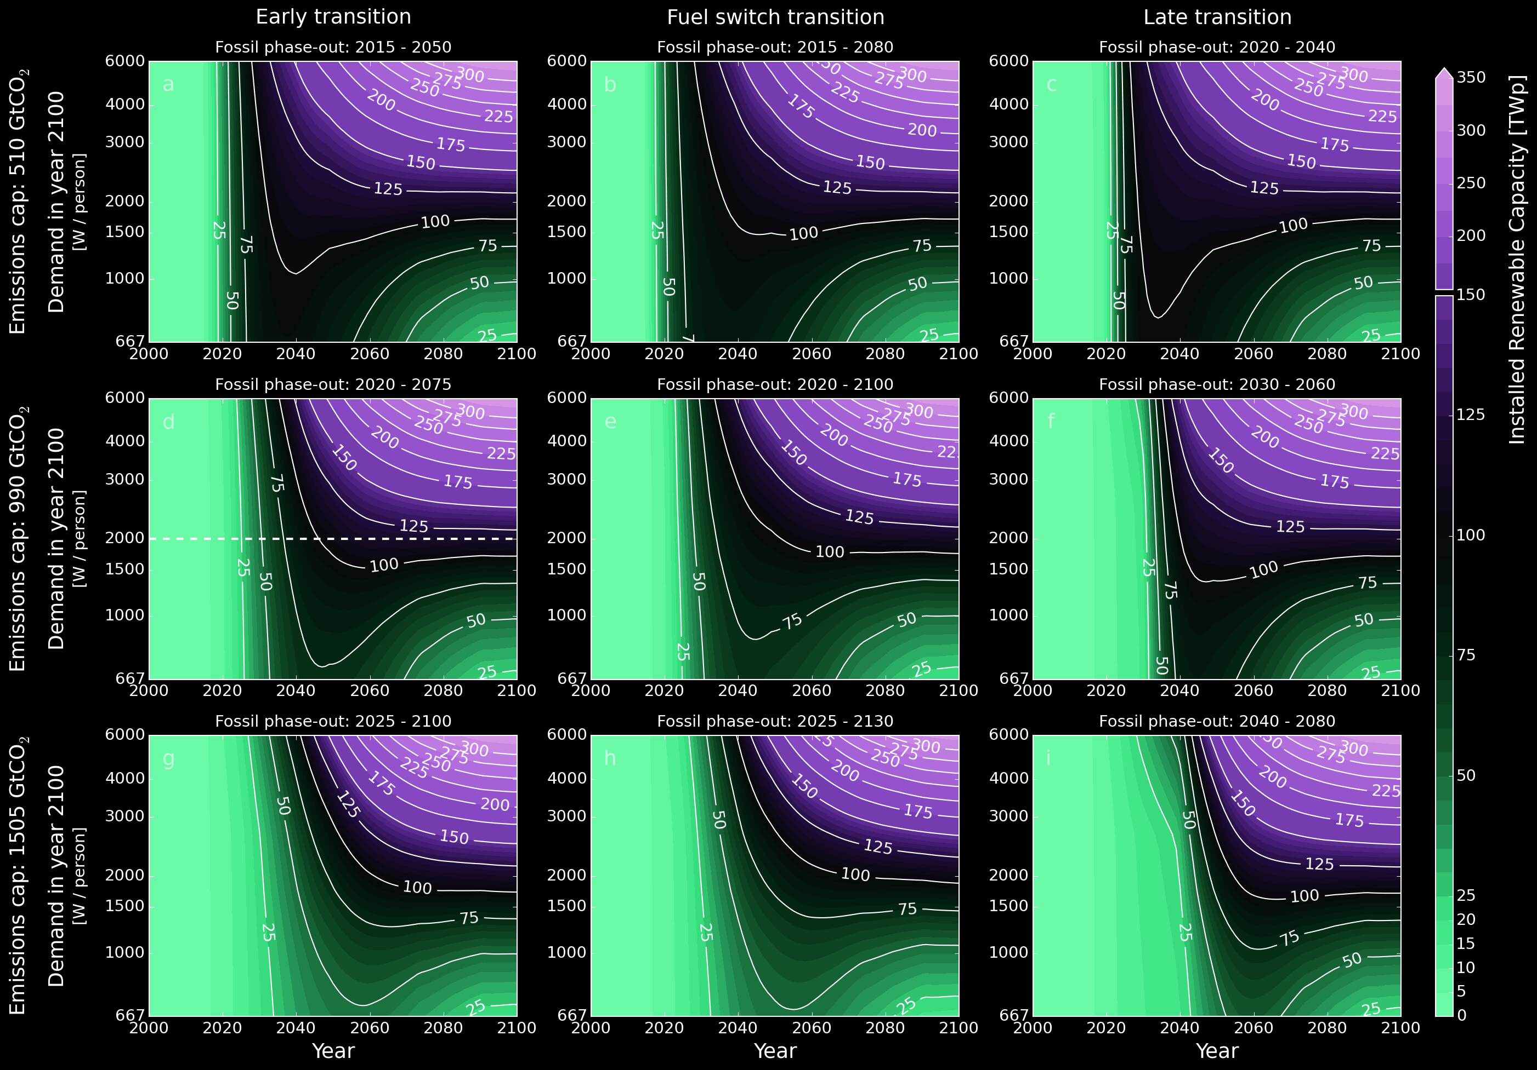
results
majority of additional capacity needs to be added before 2040
this holds even with very small final demand
transition speed critical
Sgouridis, Bardi, Csala (under review)
GRAPH: Own work
Notes:
Wealthy countries could afford to do that because of fossil fuels. 2 problems with that. Depletion and global warming.

Slide 17
modeling enigma

Slide 18



getting down to country level
Assume that countries automatically max out renewable potential of their land and import the energy needed on top of that – ideally this will be in the form of electricity – therefore assume electricity transport network development costs, including transferable storage – these costs are shared with potential excess producers.
Calculate embedded energy and emissions flows between countries using UN COMTRADE and economic energy and emissions intensity of product source countries
COP21, . . .
Run global analysis framework on countries
Trade
data
[UN COMTRADE]
Sustainable Energy Transition Paths
Renewable energy data
For countries
Renewable potential
[IRENA]

Slide 19
modeling enigma
Micro-grid
Simulation tool
Household level
Could be generalized
Hold on!
Sustainable Energy Transitions Model 2.0 | Csala (2015)
http://set.csaladen.es
Notes:
Wealthy countries could afford to do that because of fossil fuels. 2 problems with that. Depletion and global warming.

Slide 20
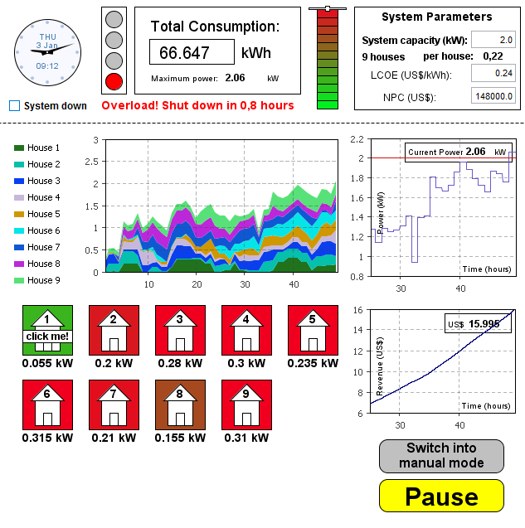
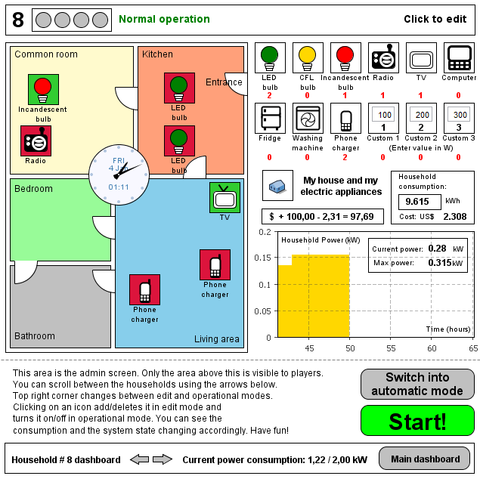
modeling enigma
Sustainable Energy Transitions Model 2.0 | Csala (2015)
http://runthemodel.com/models/1297/
Notes:
Wealthy countries could afford to do that because of fossil fuels. 2 problems with that. Depletion and global warming.

Slide 21
modeling enigma
Notes:
George Box
All models are wrong but some are useful
-create physical campus model
-Modeling methodology

Slide 22
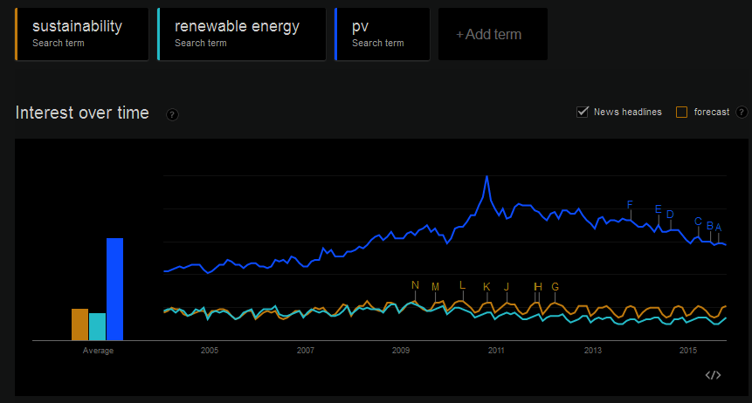
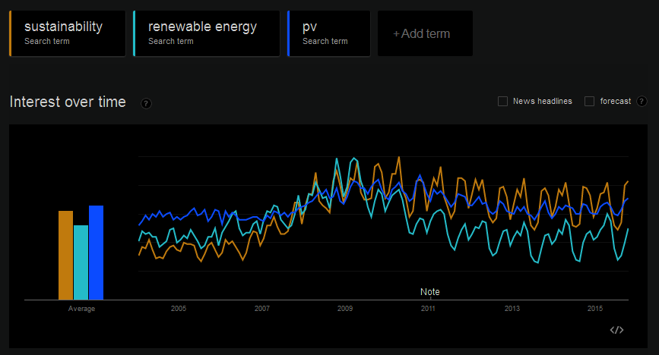
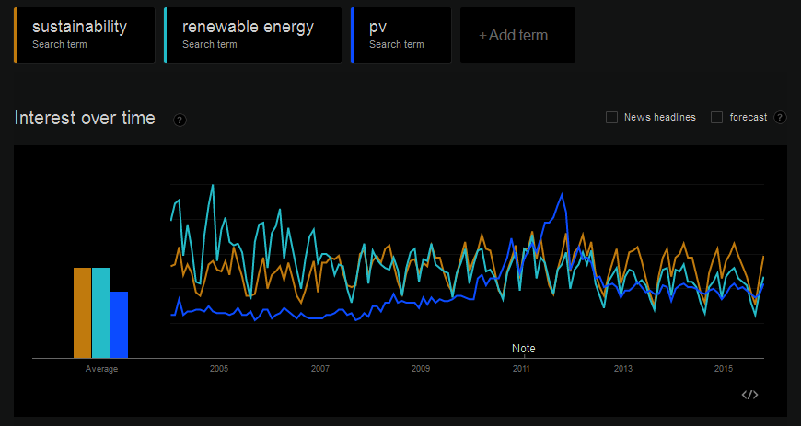
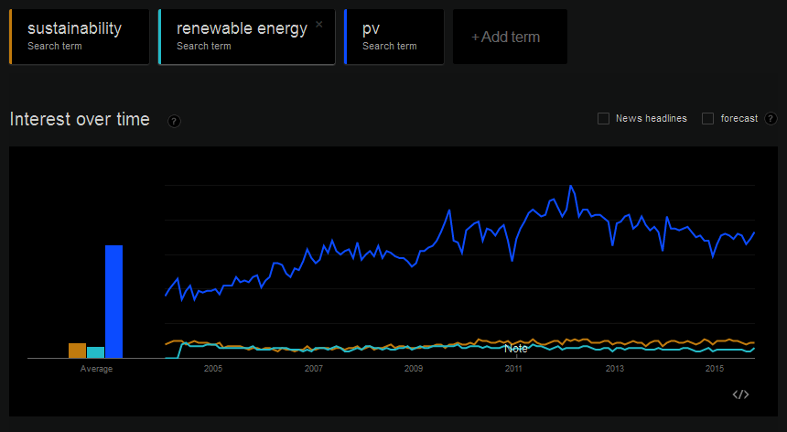
World
US
UK
Germany
GRAPH: Google Trends (2015)
Notes:
Wealthy countries could afford to do that because of fossil fuels. 2 problems with that. Depletion and global warming.

Slide 23

BBC: 24M, CNN: 19M
AJ: 6M, RT: 3M
__________________
Game of Thrones: 16M
Walking Dead: 32M
__________________
Mark Zuckerbeg: 3M
Bill Gates: 15M
__________________
Shakira: 103M
Cristiano Ronaldo: 107M
Facebook followers as of 13/10/15
Notes:
Wealthy countries could afford to do that because of fossil fuels. 2 problems with that. Depletion and global warming.

Slide 24
thank you
Dénes Csala
Modeling Complex Energy
Systems Workshop | 13/10/15
20 trillion green watts

